Slide 1
INTERVIEW QUESTION
ON
WEB BACK-END DEVELOPMENT

Slide 2
What REST stands for?
ANSWER:
REST stands for REpresentational State Transfer. REST is web standards based architecture and uses HTTP Protocol for data communication. It revolves around resource where every component is a resource and a resource is accessed by a common interface using HTTP standard methods. REST was first introduced by Roy Fielding in 2000.
In REST architecture, a REST Server simply provides access to resources and REST client accesses and presents the resources. Here each resource is identified by URIs/ global IDs. REST uses various representations to represent a resource like text, JSON and XML. Now a days JSON is the most popular format being used in web services.

Slide 3
What are the different types of NoSQL databases?
ANSWER:
A NoSQL database provides a mechanism for storage and retrieval of data that is modeled in means other than the tabular relations used in relational databases (like SQL, Oracle, etc.).
Types of NoSQL databases:
Document Oriented
Key Value
Graph
Column Oriented

Slide 4
What do you understand by NoSQL databases? Explain.
ANSWER:
At the present time, the internet is loaded with big data, big users, big complexity etc. and also becoming more complex day by day. NoSQL is answer of all these problems; It is not a traditional database management system, not even a relational database management system (RDBMS). NoSQL stands for “Not Only SQL”. NoSQL is a type of database that can handle and sort all type of unstructured, messy and complicated data. It is just a new way to think about the database.

Slide 5
What is SQL injection?
ANSWER:
Injection attacks stem from a lack of strict separation between program instructions (i.e., code) and user-provided (or external) input. This allows an attacker to inject malicious code into a data snippet.
SQL injection is one of the most common types of injection attack. To carry it out, an attacker provides malicious SQL statements through the application.
How to prevent:
Prepared statements with parameterized queries
Stored procedures
Input validation - blacklist validation and whitelist validation
Principle of least privilege - Application accounts shouldn’t assign DBA or admin type access onto the database server. This ensures that if an application is compromised, an attacker won’t have the rights to the database through the compromised application.

Slide 6
What is meant by Continuous Integration?
ANSWER:
Continuous Integration (CI) is a development practice that requires developers to integrate code into a shared repository several times a day. Each check-in is then verified by an automated build, allowing teams to detect problems early.

Slide 7
How to mitigate the SQL Injection risks?
ANSWER:
To mitigate SQL injection:
Prepared Statements with Parameterized Queries: Always ensure that your SQL interpreter always able to differentiate between code and data. Never use dynamic queries which fail to find the difference between code and data. Instead, use static SQL query and then pass in the external input as a parameter to query. Use of Prepared Statements (with Parameterized Queries) force developer to first define all the SQL code, and then pass in each parameter to the query later.
Use of Stored Procedures: Stored Procedure is like a function in C where database administrator call it whenever he/she need it. It is not completely mitigated SQL injection but definitely helps in reducing risks of SQL injection by avoiding dynamic SQL generation inside.
White List Input Validation: Always use white list input validation and allow only preapproved input by the developer. Never use blacklist approach as it is less secure than whitelist approach.
Escaping All User Supplied Input
Enforcing Least Privilege

Slide 8
Name some performance testing steps
ANSWER:
Some of the performance testing steps are:
Identify the testing environment
Identify performance metrics
Plan and design performance tests
Configure the test environment
Implement your test design
Execute tests
Analyze, report, retest

Slide 9
Name the difference between Acceptance Test and Functional Test
ANSWER:
Functional testing: This is a verification activity; did we build a correctly working product? Does the software meet the business requirements? A functional test verifies that the product actually works as you (the developer) think it does.
Acceptance testing: This is a validation activity; did we build the right thing? Is this what the customer really needs? Acceptance tests verify the product actually solves the problem it was made to solve. This can best be done by the user (customer), for instance performing his/her tasks that the software assists with.

Slide 10
What are some advantages of using Go?
ANSWER:
Go is an attempt to introduce a new, concurrent, garbage-collected language with fast compilation and the following benefits:
It is possible to compile a large Go program in a few seconds on a single computer.
Go provides a model for software construction that makes dependency analysis easy and avoids much of the overhead of C-style include files and libraries.
Go's type system has no hierarchy, so no time is spent defining the relationships between types. Also, although Go has static types, the language attempts to make types feel lighter weight than in typical OO languages.
Go is fully garbage-collected and provides fundamental support for concurrent execution and communication.
By its design, Go proposes an approach for the construction of system software on multicore machines.

Slide 11
What are the advantages of Web Services?
ANSWER:
Some of the advantages of web services are:
Interoperability: Web services are accessible over network and runs on HTTP/SOAP protocol and uses XML/JSON to transport data, hence it can be developed in any programming language. Web service can be written in java programming and client can be PHP and vice versa.
Reusability: One web service can be used by many client applications at the same time.
Loose Coupling: Web services client code is totally independent with server code, so we have achieved loose coupling in our application.
Easy to deploy and integrate, just like web applications.
Multiple service versions can be running at same time.

Slide 12
Name some Performance Testing best practices
ANSWER:
Test as early as possible in development.
Conduct multiple performance tests to ensure consistent findings and determine metrics averages.
Test the individual software units separately as well as together
Baseline measurements provide a starting point for determining success or failure
Performance tests are best conducted in test environments that are as close to the production systems as possible
Isolate the performance test environment from the environment used for quality assurance testing
Keep the test environment as consistent as possible
Calculating averages will deliver actionable metrics. There is value in tracking outliers also. Those extreme measurements could reveal possible failures.

Slide 13
What Do You Mean By High Availability (HA)?
ANSWER:
Availability means the ability of the application user to access the system, If a user cannot access the application, it is assumed unavailable. High Availability means the application will be available, without interruption. Using redundant server nodes with clustering is a common way to achieve higher level of availability in web applications.
Availability is commonly expressed as a percentage of uptime in a given year.

Slide 14
What are the difference between Clustered and a Non-clustered index?
ANSWER:
With a Clustered index the rows are stored physically on the disk in the same order as the index. Therefore, there can be only one clustered index. A clustered index means you are telling the database to store close values actually close to one another on the disk.
With a Non Clustered index there is a second list that has pointers to the physical rows. You can have many non clustered indices, although each new index will increase the time it takes to write new records.
It is generally faster to read from a clustered index if you want to get back all the columns. You do not have to go first to the index and then to the table.
Writing to a table with a clustered index can be slower, if there is a need to rearrange the data.

Slide 15
How does SSL/TLS work ?
ANSWER:
SSL (and its successor, TLS) is a protocol that operates directly on top of TCP. This way, protocols on higher layers (such as HTTP) can be left unchanged while still providing a secure connection. Underneath the SSL layer, HTTP is identical to HTTPS. When using SSL/TLS correctly, all an attacker can see on the cable is which IP and port you are connected to, roughly how much data you are sending, and what encryption and compression is used. He can also terminate the connection, but both sides will know that the connection has been interrupted by a third party.
After building a TCP connection, the SSL handshake is started by the client that sends a number of specifications:
which version of SSL/TLS it is running,
what ciphersuites it wants to use, and
what compression methods it wants to use.
The server checks what the highest SSL/TLS version is that is supported by them both, picks a ciphersuite from one of the client's options (if it supports one), and optionally picks a compression method.
After this the basic setup is done, the server sends its certificate. This certificate must be trusted by either the client itself or a party that the client trusts. Having verified the certificate and being certain this server really is who he claims to be (and not a man in the middle), a key is exchanged. The client tells the server that from now on, all communication will be encrypted, and sends an encrypted and authenticated message to the server.
The server verifies that the MAC (used for authentication) is correct, and that the message can be correctly decrypted. It then returns a message, which the client verifies as well.
The handshake is now finished, and the two hosts can communicate securely.

Slide 16
When to use MongoDB?
ANSWER:
Use MongoDB if you don't know yet how you're going to query your data or what schema to stick with. MongoDB is suited for Hackathons, startups or every time you don't know how you'll query the data you inserted. MongoDB does not make any assumptions on your underlying schema. While MongoDB is schemaless and non-relational, this does not mean that there is no schema at all. It simply means that your schema needs to be defined in your app (e.g. using Mongoose). Besides that, MongoDB is great for prototyping or trying things out. Its performance is not that great and can't be compared to Redis.

Slide 17
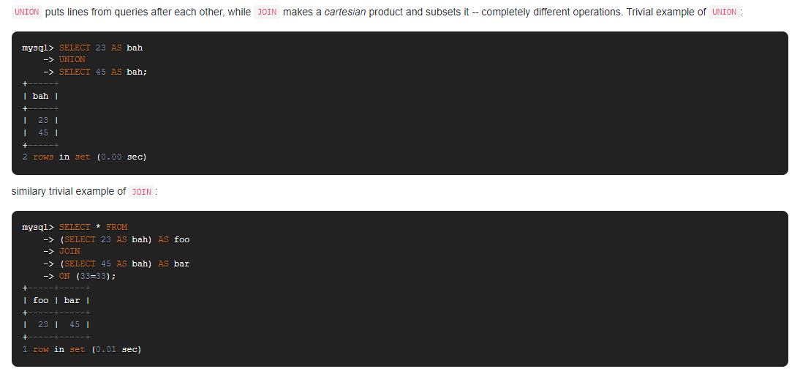
What is the difference between JOIN and UNION?
ANSWER:

Slide 18
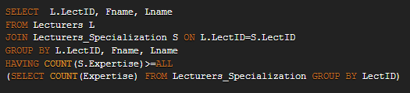
What is the difference between WHERE clause and HAVING clause?
ANSWER:
WHERE clause introduces a condition on individual rows; HAVING clause introduces a condition on aggregations, i.e. results of selection where a single result, such as count,
average, min, max, or sum, has been produced from multiple rows. Your query calls for a second kind of condition (i.e. a condition on an aggregation) hence HAVING works correctly.
As a rule of thumb, use WHERE before GROUP BY and HAVING after GROUP BY. It is a rather primitive rule, but it is useful in more than 90% of the cases.
While you're at it, you may want to re-write your query using ANSI version of the join:

Slide 19
What is the use of ini_set()?
ANSWER:
PHP allows the user to modify some of its settings mentioned in php.ini using ini_set(). This function requires two string arguments. First one is the name of the setting to be modified and the second one is the new value to be assigned to it.
Given line of code will enable the display_error setting for the script if it’s disabled.
ini_set('display_errors', '1');
We need to put the above statement, at the top of the script so that, the setting remains enabled till the end. Also, the values set via ini_set() are applicable, only to the current script. Thereafter, PHP will start using the original values from php.ini.

Slide 20
What does $GLOBALS mean?
ANSWER:
$GLOBALS is associative array including references to all variables which are currently defined in the global scope of the script.

Slide 21
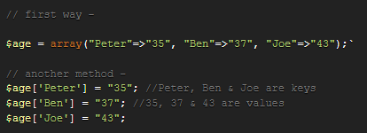
What do we mean by keys and values?
ANSWER:
In associative arrays, we can use named keys that you assign to them. There are two ways to create an associative array:

Slide 22
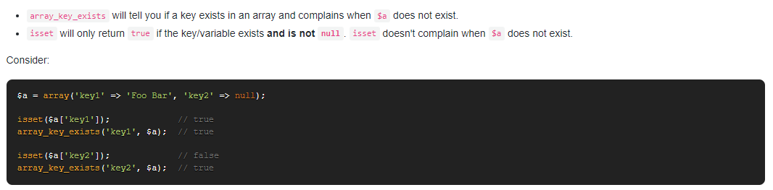
What's the difference between isset() and array_key_exists()?
ANSWER:

Slide 23
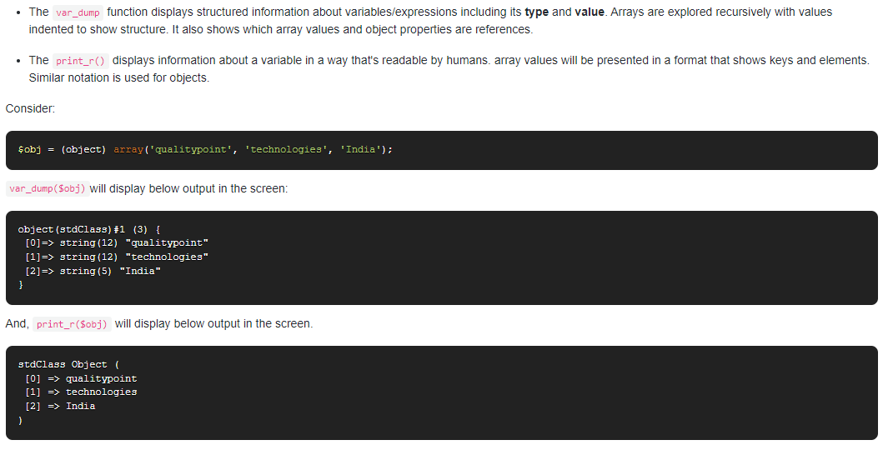
What is the difference between var_dump() and print_r()?
ANSWER:

Slide 24
Differentiate between echo and print()
ANSWER:
echo and print are more or less the same. They are both used to output data to the screen.
The differences are:
echo has no return value while print has a return value of 1 so it can be used in expressions.
echo can take multiple parameters (although such usage is rare) while print can take one argument.
echo is faster than print.

Slide 25
How can you enable error reporting in PHP?
ANSWER:
Check if “display_errors” is equal “on” in the php.ini or declare “ini_set('display_errors', 1)” in your script.
Then, include “error_reporting(E_ALL)” in your code to display all types of error messages during the script execution.

Slide 26
What are the differences between die() and exit() functions in PHP?
ANSWER:
There's no difference - they are the same. The only advantage of choosing die() over exit(), might be the time you spare on typing an extra letter.

Slide 27
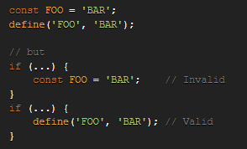
What are the main differences between const vs define
ANSWER:
The fundamental difference between const vs define is that const defines constants at compile time, whereas define defines them at run time.
Also until PHP 5.3, const could not be used in the global scope. You could only use this from within a class. This should be used when you want to set some kind of constant option or setting that pertains to that class. Or maybe you want to create some kind of enum. An example of good const usage is to get rid of magic numbers.
Define can be used for the same purpose, but it can only be used in the global scope. It should only be used for global settings that affect the entire application.
Unless you need any type of conditional or expressional definition, use consts instead of define()- simply for the sake of readability!

Slide 28
What is Git?
ANSWER:
Git is a Distributed Version Control system (DVCS). It can track changes to a file and allows you to revert back to any particular change.
Its distributed architecture provides many advantages over other Version Control Systems (VCS) like SVN one major advantage is that it does not rely on a central server to store all the versions of a project’s files.

Slide 29
Explain Null and Undefined in JavaScript
ANSWER:
JavaScript (and by extension TypeScript) has two bottom types: null and undefined. They are intended to mean different things:
Something hasn't been initialised : undefined.
Something is currently unavailable: null.

Slide 30


What does use strict do?
ANSWER:
The use strict literal is entered at the top of a JavaScript program or at the top of a function and it helps you write safer JavaScript code by throwing an error if a global variable is created by mistake. For example, the following program will throw an error:
It will throw an error because x was not defined and it is being set to some value in the global scope, which isn't allowed with use strict The small change below fixes the error being thrown:

Slide 31
Is there anyway to force using strict mode in Node.js?
ANSWER:
you can place
"use strict";
at the top of your file in node >= 0.10.7, but if you want your whole app to run in strict (including external modules) you can do this
node --use_strict

Slide 32
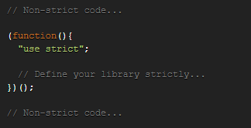
What is strict mode?
ANSWER:
Strict Mode is a new feature in ECMAScript 5 that allows you to place a program, or a function, in a "strict" operating context. This strict context prevents certain actions from being taken and throws more exceptions.

Slide 33
What is the difference between TRUNCATE and DELETE?
ANSWER:
DELETE is a Data Manipulation Language(DML) command. It can be used for deleting some specified rows from a table. DELETE command can be used with WHERE clause.
TRUNCATE is a Data Definition Language(DDL) command. It deletes all the records of a particular table. TRUNCATE command is faster in comparison to DELETE. While DELETE command can be rolled back, TRUNCATE can not be rolled back in MySQL.

Slide 34
What is Primary Key Constraint and Unique Key Constraints?
ANSWER:
Primary key is a column or a group of columns in table which uniquely identifies a row in database. A primary key column can not have NULL value. Values in primary key column or columns must be unique so that a row or entry can be uniquely identified using primary key.
Unique key constraint ensures that values entered in a column are unique. Although primary key values will be unique, you might want to ensure that some other column also has non-duplicate entries. For example if we have multiple users and want to ensure that no two users with same email id are added to the table, we can put UNIQUE key constraint on email_id column. NULL values are ignored in case of Unique key constraint which means NULL is allowed value for email id in this case.

Slide 35
What are Key Features of MongoDB?
ANSWER:
MongoDB is an open-source document database that provides high performance, high availability, and automatic scaling.
Its Key Features are:
Document Oriented and NoSQL database.
Supports Aggregation
Uses BSON format
Sharding (Helps in Horizontal Scalability)
Supports Ad Hoc Queries
Schema Less
Capped Collection
Indexing (Any field in MongoDB can be indexed)
MongoDB Replica Set (Provides high availability)
Supports Multiple Storage Engines
ACID compliance including multi-document transactions support (starting from v. 4)

Slide 36
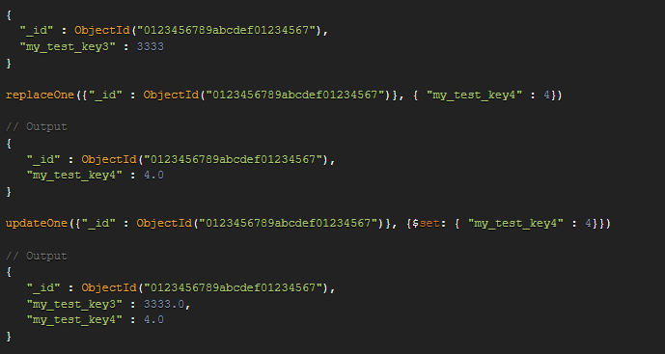
What's the difference between replaceOne() and updateOne() in MongoDB?
ANSWER:
With replaceOne() you can only replace the entire document
While updateOne() allows for updating fields.
Since replaceOne() replaces the entire document - fields in the old document not contained in the new will be lost.
With updateOne() new fields can be added without losing the fields in the old document.
For example:

Slide 37
What is Object-Oriented Programming (OOP)?
ANSWER:
OOP is a technique to develop logical modules, such as classes that contain properties, methods, fields, and events. An object is created in the program to represent a class. Therefore, an object encapsulates all the features, such as data and behavior that are associated to a class. OOP allows developers to develop modular programs and assemble them as software. Objects are used to access data and behaviors of different software modules, such as classes, namespaces, and sharable assemblies. .NET Framework supports only OOP languages, such as Visual Basic .NET, Visual C#, and Visual C++.

Slide 38
What is a class?
ANSWER:
A class describes all the attributes of objects, as well as the methods that implement the behavior of member objects. It is a comprehensive data type, which represents a blue print of objects. It is a template of object.
A class can be defined as the primary building block of OOP. It also serves as a template that describes the properties, state, and behaviors common to a particular group of objects.
A class contains data and behavior of an entity. For example, the aircraft class can contain data, such as model number, category, and color and behavior, such as duration of flight, speed, and number of passengers. A class inherits the data members and behaviors of other classes by extending from them.

Slide 39
What is an object?
ANSWER:
Objeects are instance of classes. It is a basic unit of a system. An object is an entity that has attributes, behavior, and identity. Attributes and behavior of an object are defined by the class definition.

Slide 40
What is a progressive web app?
ANSWER:
The concept of the progressive web app (PWA) was approached by Google in late 2015. They are basically web applications (Website) but have look and feel like other native mobile apps. The progressive web app enabled websites can offer functionalities such as working offline, push notifications, and device hardware access.

Slide 41
Why do we need a web manifest for PWA?
ANSWER:
A web manifest file lists all the information about the website in a JSON format. Having this file is one of the requirements to make the website installable.
It usually resides in the root folder of a web app. It contains useful information, such as the app’s title, paths to different-sized icons that can be used to represent the app on a mobile OS (for example, as the home screen icon), and a background color to use in loading or splash screens. This information is needed for the browser to present the web app properly when installing, and on the home screen.

Slide 42
What makes an app a PWA?
ANSWER:
There are some key principles a web app should try to observe to be identified as a PWA. It should be:
Discoverable, so the contents can be found through search engines.
Installable, so it's available on the device's home screen.
Linkable, so you can share it by simply sending a URL. * Network independent, so it works offline or with a poor network connection.
Progressive, so it's still usable on a basic level on older browsers, but fully-functional on the latest ones.
Re-engageable, so it's able to send notifications whenever there's new content available.
Responsive, so it's usable on any device with a screen and a browser — mobile phones, tablets, laptops, TVs, fridges, etc.
Safe, so the connection between you and the app is secured against any third parties trying to get access to your sensitive data.

Slide 43
How does React work?
ANSWER:
React creates a virtual DOM. When state changes in a component it firstly runs a "diffing" algorithm, which identifies what has changed in the virtual DOM. The second step is reconciliation, where it updates the DOM with the results of diff.

Slide 44
What is the difference between state and props?
ANSWER:
The state is a data structure that starts with a default value when a Component mounts. It may be mutated across time, mostly as a result of user events.
Props (short for properties) are a Component's configuration. They are received from above and immutable as far as the Component receiving them is concerned. A Component cannot change its props, but it is responsible for putting together the props of its child Components. Props do not have to just be data - callback functions may be passed in as props.

Slide 45
What are advantages of using React Hooks?
ANSWER:
Primarily, hooks in general enable the extraction and reuse of stateful logic that is common across multiple components without the burden of higher order components or render props. Hooks allow to easily manipulate the state of our functional component without needing to convert them into class components.
Hooks don’t work inside classes (because they let you use React without classes). By using them, we can totally avoid using lifecycle methods, such as componentDidMount, componentDidUpdate, componentWillUnmount. Instead, we will use built-in hooks like useEffect .

Slide 46
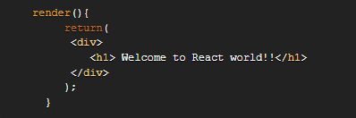
What is JSX?
ANSWER:
JSX is a syntax notation for JavaScript XML (XML-like syntax extension to ECMAScript). It stands for JavaScript XML. It provides expressiveness of JavaScript along with HTML like template syntax. For example, the below text inside h1 tag return as javascript function to the render function,

Slide 47
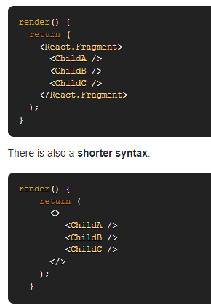
What are Fragments in React?
ANSWER:
It's common pattern in React which is used for a component to return multiple elements. Fragments let you group a list of children without adding extra nodes to the DOM.

Slide 48
What are React Hooks?
ANSWER:
Hooks are a new addition in React 16.8. They let you use state and other React features without writing a class. With Hooks, you can extract stateful logic from a component so it can be tested independently and reused. Hooks allow you to reuse stateful logic without changing your component hierarchy. This makes it easy to share Hooks among many components or with the community.

Slide 49
What is the use of jQuery .each() function?
ANSWER:
The $.each() function is used to iterate over a jQuery object. The $.each() function can be used to iterate over any collection, whether it is an object or an array.

Slide 50
What is event.PreventDefault()?
ANSWER:
The event.preventDefault() method stops the default action of an element from happening. For example, Prevents a link from following the URL.

Slide 51
What npm is used for?
ANSWER:
npm stands for Node Package Manager. npm provides the following two main functionalities:
Online repositories for Node.js packages/modules which are searchable on search.nodejs.org
Command-line utility to install packages, do version management and dependency management of Node.js packages.
Another important use for npm is dependency management. When you have a node project with a package.json file, you can run npm install from the project root and npm will install all the dependencies listed in the package.json.

